Slide 1



Spotting Spammer using Group Spammer Behaviour Analysis
1
Submitted as Final Year Project Towards completion of BS COMPUTER Science
Project Supervisor: DR. Hamid Turab Mirza

Slide 2
Team Introduction
2
Name Registration# Email
Kafeel Ahmad Butt CUI-SP16-BCS-187 kafeelbutt45@gmail.com
Sheikh Muhammad Qasim CUI-SP16-BCS-019 q.shaikh14@gmail.com
Omer Tariq CUI-SP16-BCS-083 om3r.tariq97@gmail.com

Slide 3
Background
3
Reviews have a great influence over the sentiment of a product.
Crowdsourcing websites are the best source of information for buyers today.
Less work on group spam.
Spammers getting paid.

Slide 4
Related Work
4
Most of the work done on this topic is quite respectable. Some of the work done in this field are stated as follows:
The most popular works done on group spammers was done by Mukherjee et al.[1].
Ahsan et al [2] uses active learning to detect review spamming.
Adike, M. R., and Vivekanand Reddy [3] recognize spam reviews based on sentiment analysis.
Xu, G., Hu et al [4] uses suspicious reviewer graph to detect suspicious clusters of reviewers.
They detect spam problem as a network classification task Shebuti et al [5].

Slide 5
Research Issue
5
Fake reviewers and working in groups?
Ever heard of fake news?
Similarly, there are fake reviews!
Fake reviews have the power to control the sentiment of a product.
Community blogs can change the view of public about some issue.
Similarly, fake reviews can influence the view about a target product greatly.
Worse part is the fake reviewers have started working in groups.
People want reviews to be:
Authentic,
Truthful,
Real.

Slide 6
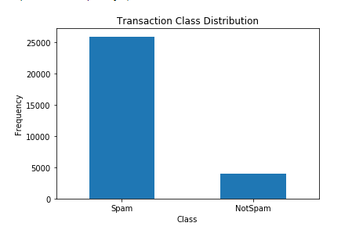
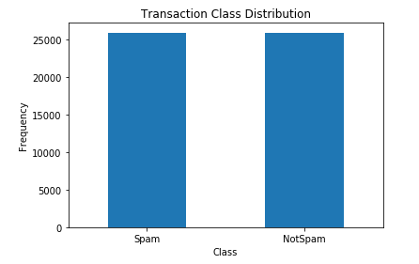
System’s Introduction
6
Data Pre-processing.
Data importing.
Handling imbalanced datasets.
Bi-variate Analysis.
Working
Hints from behavioral data and interpersonal data to construct a suspicious reviewer graph.
Break the whole suspicious reviewer graph into k-clique clusters.
Candidate group spammers.
Ranks candidate groups.
Technologies
Python
Django
NLP
Deep Learning

Slide 7
System’s Introduction Cont.
7
Feature extraction.
Extracting unigrams, bigrams, trigrams.
TF-IDF Vectorizing i.e. term frequency and inverse document frequency.
Count Vectorizing i.e. word count.
Choosing best model.
Applying six models.
With different values of k and a .
Saving models.
Classification of new reviews.
Applying model on newly extracted reviews.
Classifier classifies “spam” or “not spam”.
K-Clique model will tell us which group it belongs to if spam.

Slide 8
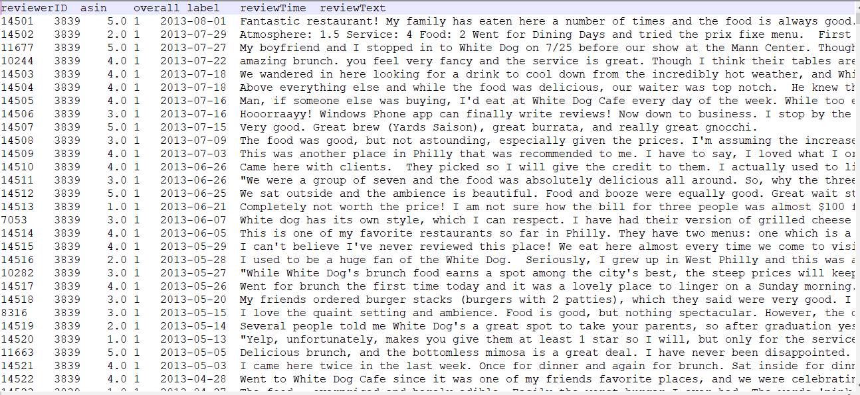
Data Set
8
Two datasets used during research.
Amazon dataset (Electronics, Books, DVDs)
Dataset from Yelp.com

Slide 9
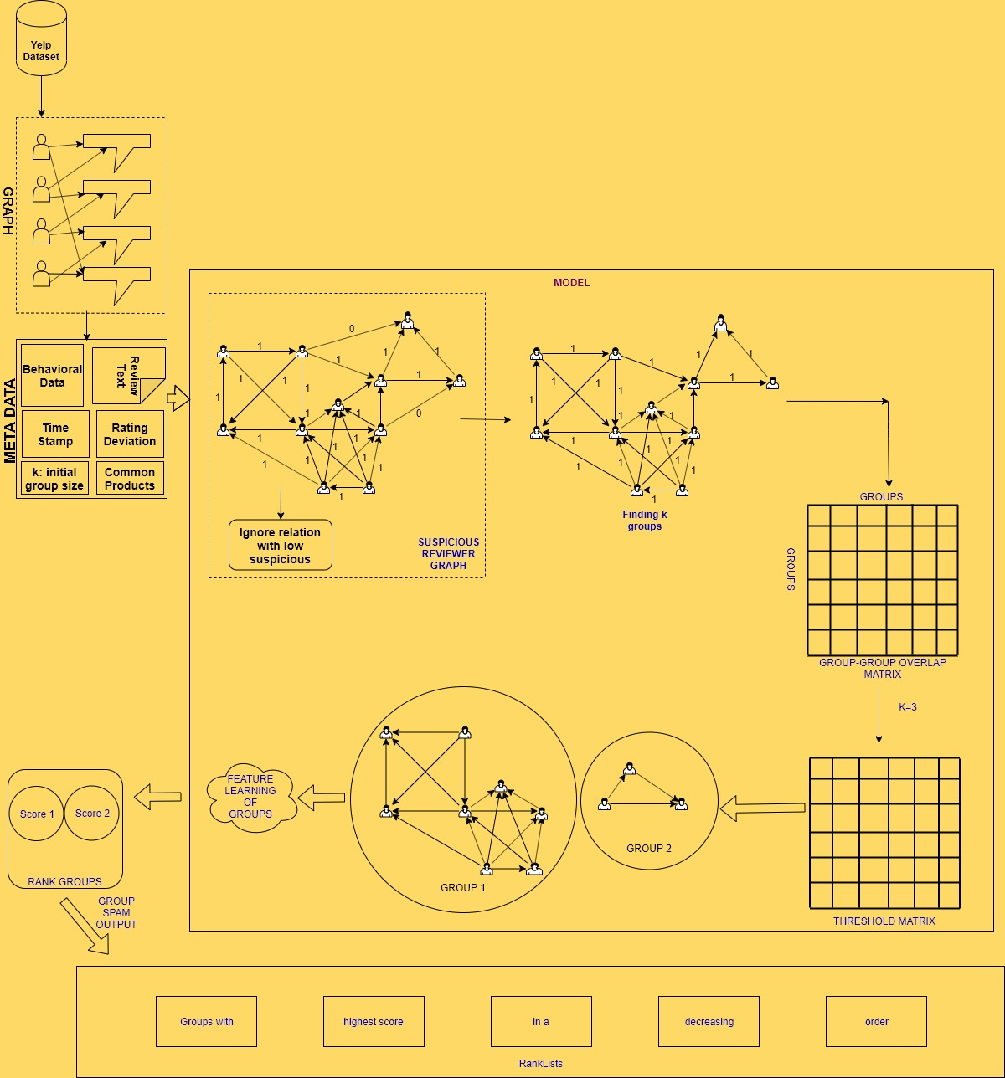
System’s Architecture
9

Slide 10
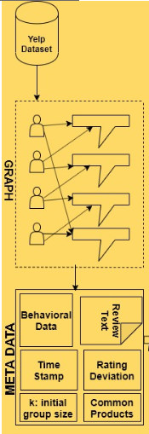
Step 1
10
G = (V,E)
Find the METADATA
Provide the initial group size.

Slide 11
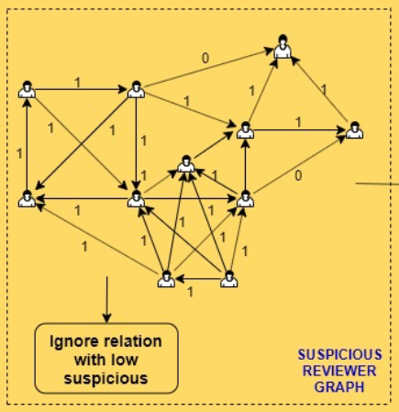
Step 2
11
Filter out reviews.
Construct suspicious reviewer graph.
RS(i; j; p) represents the co-review similarity of i and j co-review a product p.

Slide 12
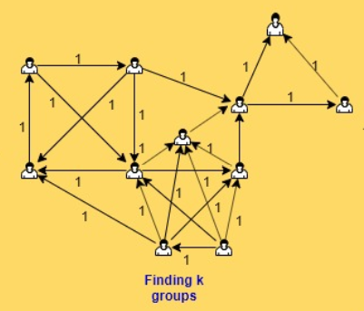

Step 3
12
Find the k-cliques (groups) in the suspicious graph.
Learn the features of all the suspicious reviewers.
Computationally inefficient.

Slide 13
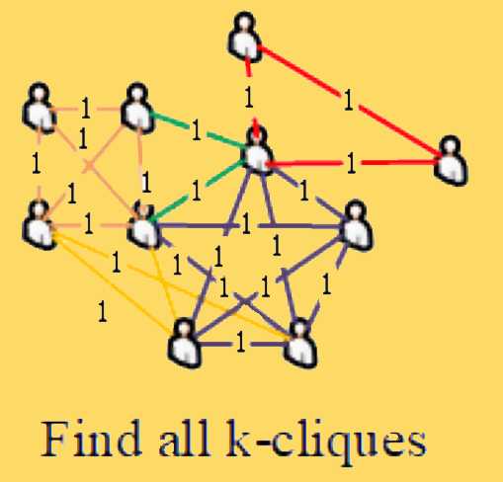
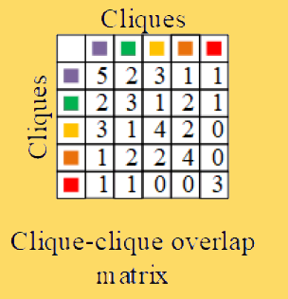
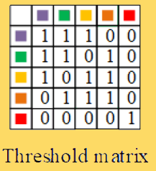
Step 4
13
Each row (and column) represents a group.
Elements are equal to the number of common nodes.
Diagonal entries are equal to the size of the clique.
Construct the threshold matrix.
the off-diagonal elements that are less than k-1 and the diagonal elements that are less than k are set to 0, and the other elements are set to 1.

Slide 14
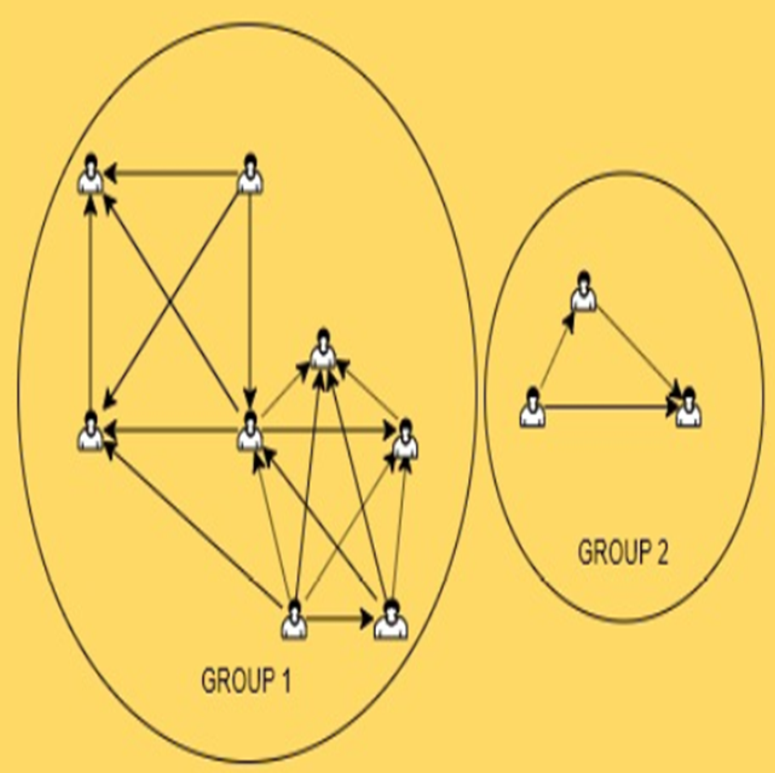
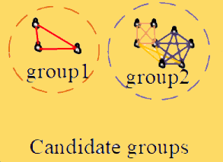
Step 5
14
Get candidate group spammers.
Corresponding diagonal entry is 1
Adjacent when corresponding off-diagonal element was 1.

Slide 15
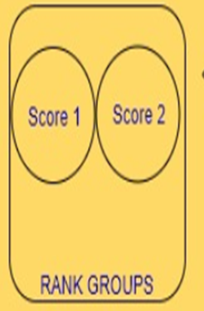

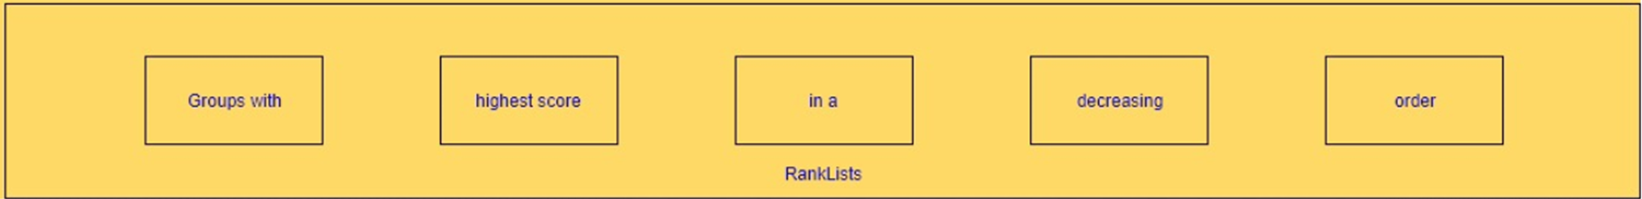
Step 6 & 7
15
Learn features:
Average Rating Deviation (AVG)
Group Deviation (GD)
Review Burst Ratio (BS)
Group Size (GS)
Group Size Ratio (GSR)
Review Tightness (RT)
Group Support Count
Group Content Similarity (GCS)
Rank Candidate Groups

Slide 16
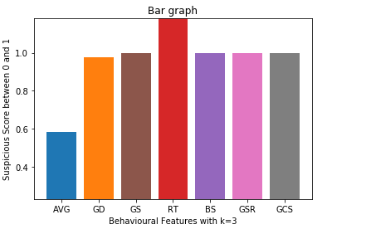
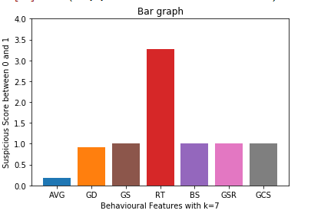
Results of Behavioral Features
16
Suspicious score between 0 and 1 and k=3
Suspicious score between 0 and 1 and k=7

Slide 17
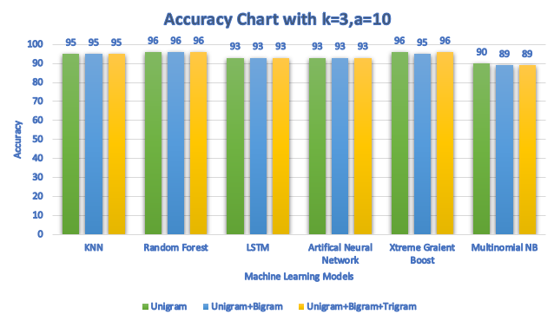
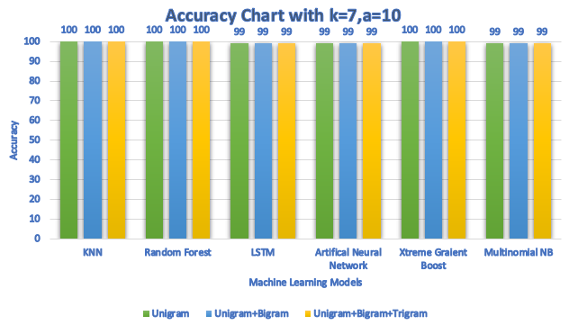
Algorithms Applied
17
Six algorithms were applied with k=3, k=7 and a=10 using Count Vectorizer
Naïve Bayes
Random Forest
K-Nearest Neighbour
Long Short Term Memory
Xtreme Gradient Boost
Artificial Neural Network

Slide 18
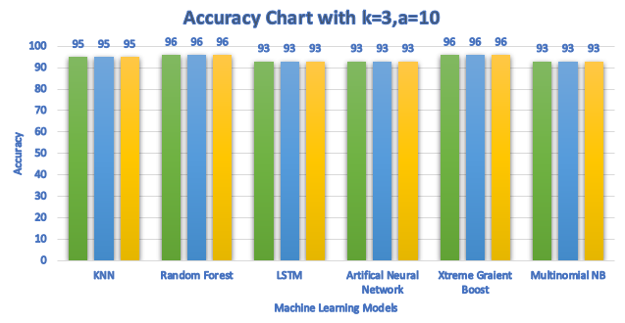
Algorithms Applied
18
Six algorithms were applied with k=3, k=7 and a=10 using TF-IDF Vectorizer
Naïve Bayes
Random Forest
K-Nearest Neighbour
Long Short Term Memory
Xtreme Gradient Boost
Artificial Neural Network

Slide 19
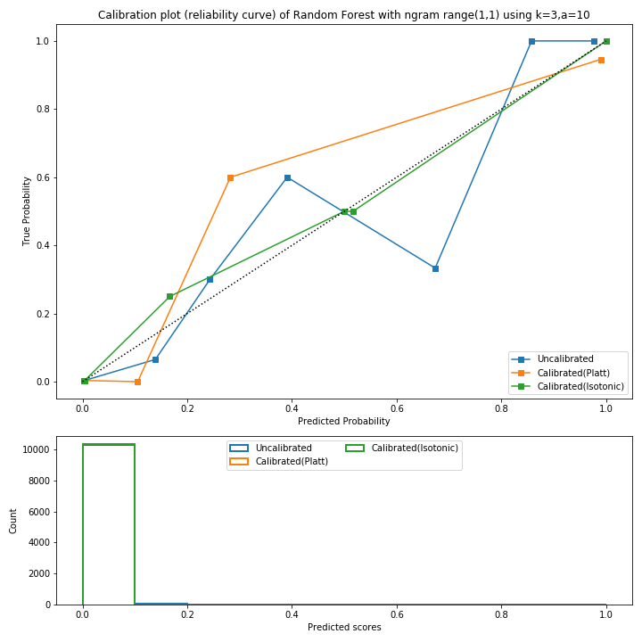
Comparison
19
Naïve Bayes is the worst as it shows a flat line on all points.
Random Forest worked the most prominent as it is predicting values very close to perfectly calibrated through isotonic calibration.
XGBoost shows the opposite of Random Forest.
ANN has proven to be the least efficient.
LSTM’s isotonic regression is the second lowest.
KNN is perfectly calibrated until 0.8 and works fine but gets uncalibrated after that.
Calibration curves are used to understand the instrumental response to an analyte and predict the concentration in an unknown sample.
Results were taken on unigram, unigram + bigram and unigram + bigram + trigram when k=3 and a =10 using TF-IDF Vectorizer and the results were almost same. In fact, it was still similar when k was changed to 7. Probability Calibration curves of all the classifier used in our project when k=3 and unigram, are shown and here is a summary of the resud works fine but gets uncalibrated after that.

Slide 20
Linguistic Features for Classifiers
20
Worked on unigram, unigram + bigram, and unigram + bigram + trigram
Works on the algorithm with best accuracy, i.e. Random Forest Classifier or XGBoost.
We chose Random Forest Classifier with k=3 and unigram for our case.
Behavioral Features indicates the suspicious score of candidate group of the spam review.

Slide 21
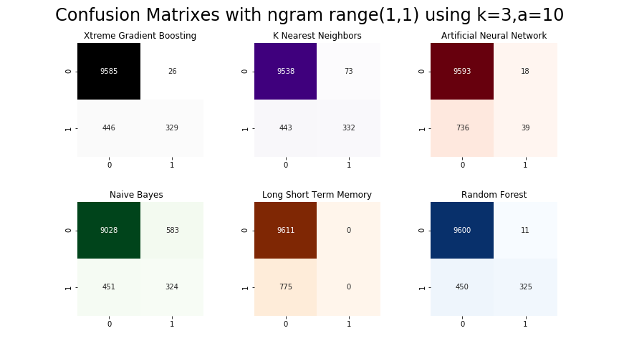
Results and Calculations
21
[[9600 11]
[450 325]]
Trained model on 41542 reviews
Dataset was of 50000 reviews
10386 reviews for test data
Choose Random Forest
Got 75 groups
k=3 and unigram
Accuracy score is 0.9556
Correct Classifications | Missed Classifications
9925 | 461
Precision | Recall | F-Measure | AUROC
0.96 | 0.96 | 0.95 | 0.71

Slide 22





Prototype Powered By: Research, Python(Scikit-learn, Numpy, Pandas, NLKT, Matplotlib, pillow for handling images, datetime), Django, PostgreSQL, psycopg, ORM (Object Relational Mapper), Code First, pip, Machine Learning
22

Slide 23

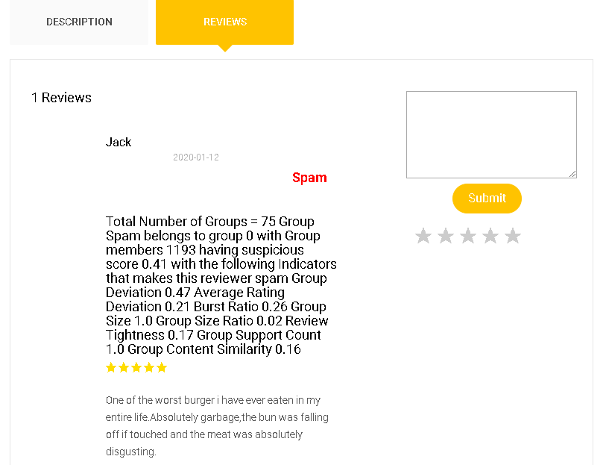
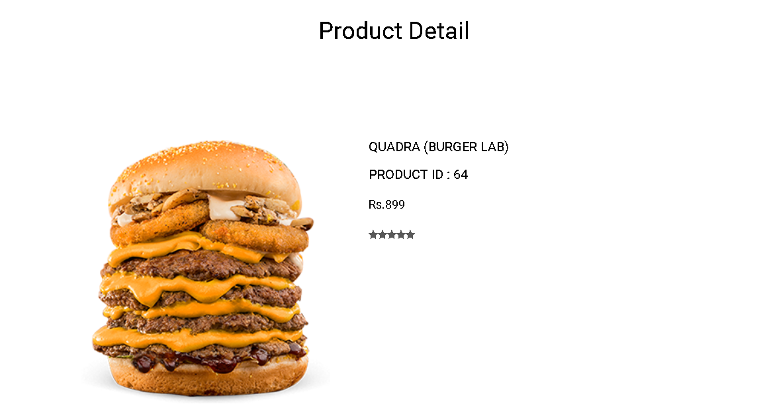
Web Interface
23

Slide 24
Future Work
24
Extending the scope to other data sets.
As system comes in proper running form, we can save user’s data like location, time, IP Addresses to make our model more precise.
Can be helpful to researchers for further work and to build a well-organized prototype.

Slide 25
References
25
[1] Mukherjee, A., Liu, B., & Glance, N. (2012, April). Spotting fake reviewer groups in consumer reviews. In Proceedings of the 21st international conference on World Wide Web (pp. 191-200). ACM.
[2] Ahsan, M. I., Nahian, T., Kafi, A. A., Hossain, M. I., & Shah, F. M. (2016, October). Review spam detection using active learning. In Information Technology, Electronics and Mobile Communication Conference (IEMCON), 2016 IEEE 7th Annual (pp. 1-7). IEEE.
[3] Adike, M. R., & Reddy, V. (2016). Detection of fake review and brand spam using data mining. Int J Recent Trends Eng Res, 2(7), 251-256
[4] Xu, G., Hu, M., Ma, C., & Daneshmand, M. (2019, May). GSCPM: CPM-Based Group Spamming Detection in Online Product Reviews. In ICC 2019-2019 IEEE International Conference on Communications (ICC) (pp. 1-6). IEEE.
[5] Rayana, S., & Akoglu, L. (2015, August). Collective opinion spam detection: Bridging review networks and metadata. In Proceedings of the 21th acm sigkdd international conference on knowledge discovery and data mining (pp. 985-994). ACM.

